Slide 1
DROWCULA
Dimensionally Reduced Open-World Clustering
Erencem Ozbey & Dimitrios I. Diochnos
NeurIPS 2025 | Bogazici University & University of Oklahoma

Slide 2
The Problem: Open-World Clustering
Novel Class Discovery (NCD): Real-world data contains unknown classes not seen during training
Semi-supervised limitation: NCD methods require labeled data (unfair advantage)
Curse of dimensionality: High-dimensional embeddings hurt clustering quality
Unknown cluster count: We can't assume knowing the number of clusters
Goal: Discover novel categories completely unsupervised

Slide 3
Real-World Applications
Disease Detection
Identify novel virus strains without pre-labeled examples
Image Categorization
Auto-organize photos into unknown groups
Foundation Models
Leverage vast unlabeled data efficiently

Slide 4
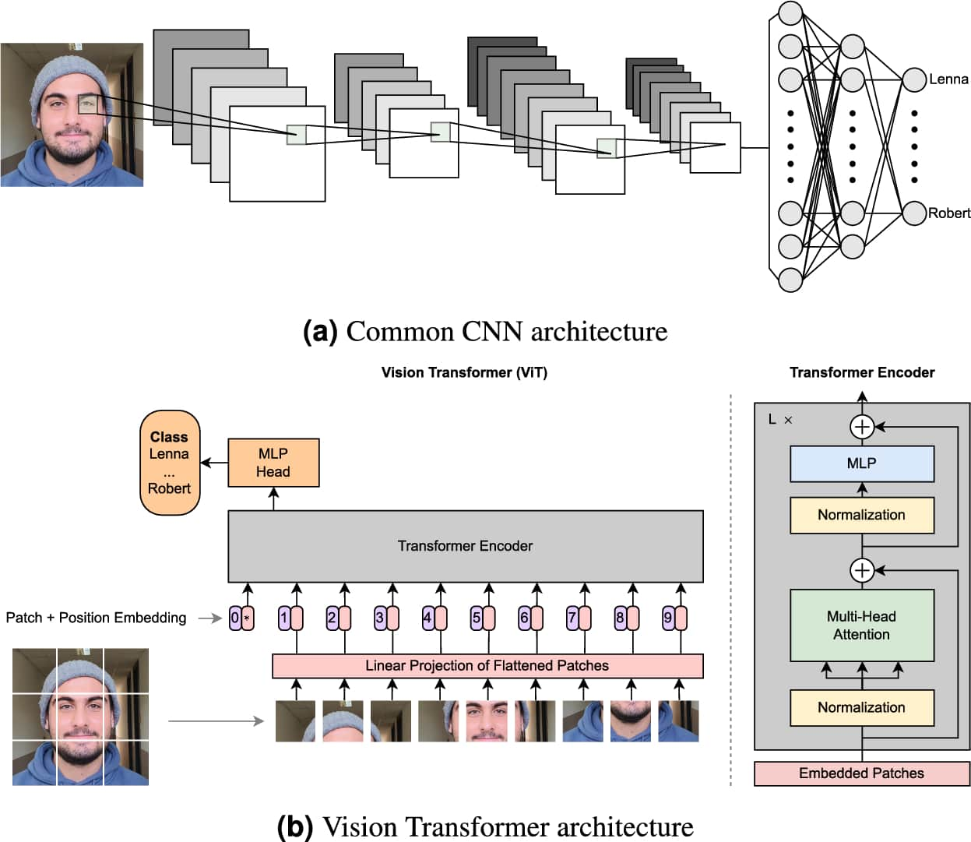
Background: Clustering Landscape
Traditional: K-means, K-medoids, DBSCAN
Deep clustering: TURTLE, PRO-DSC, TEMI
ViT-based: DINOv2 embeddings
Manifold learning: UMAP, t-SNE, Isomap

Slide 5
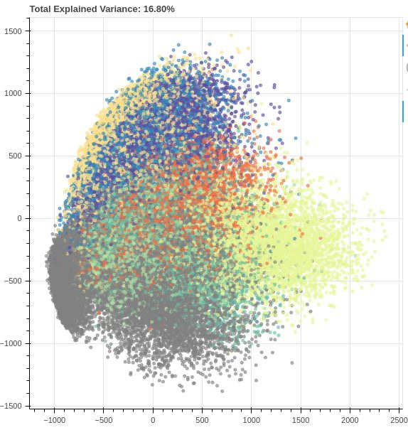
The Curse of Dimensionality
In high dimensions, all points appear equally distant
Euclidean distance becomes meaningless
Solution: Preserve local structure with manifold learning

Slide 6
DROWCULA Pipeline
Step 1: Vision Transformer Embeddings (DINOv2-giant) → 1536D
Step 2: L2 Normalization
Step 3: Manifold Dimension Reduction (UMAP/t-SNE) → 2-3D
Step 4: K-means Clustering
Step 5: Bayesian Optimization for Cluster Count

Slide 7
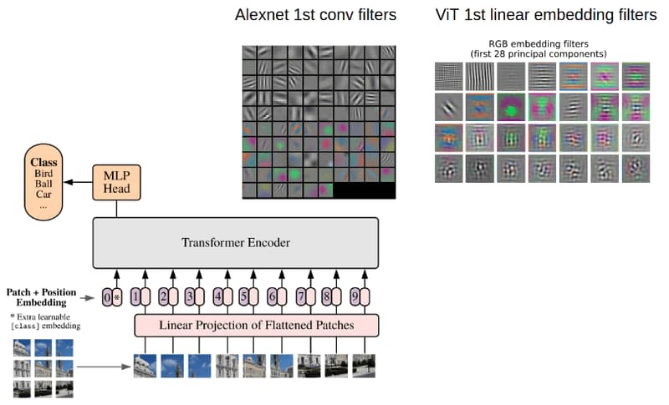
Why Vision Transformers (ViT)?
Global attention: Capture long-range dependencies
Dataset-agnostic: Not tied to specific training data
Rich embeddings: DINOv2-giant produces 1536D vectors
Self-supervised: Preserves natural class structure
State-of-the-art: Superior to CNN features for clustering

Slide 8
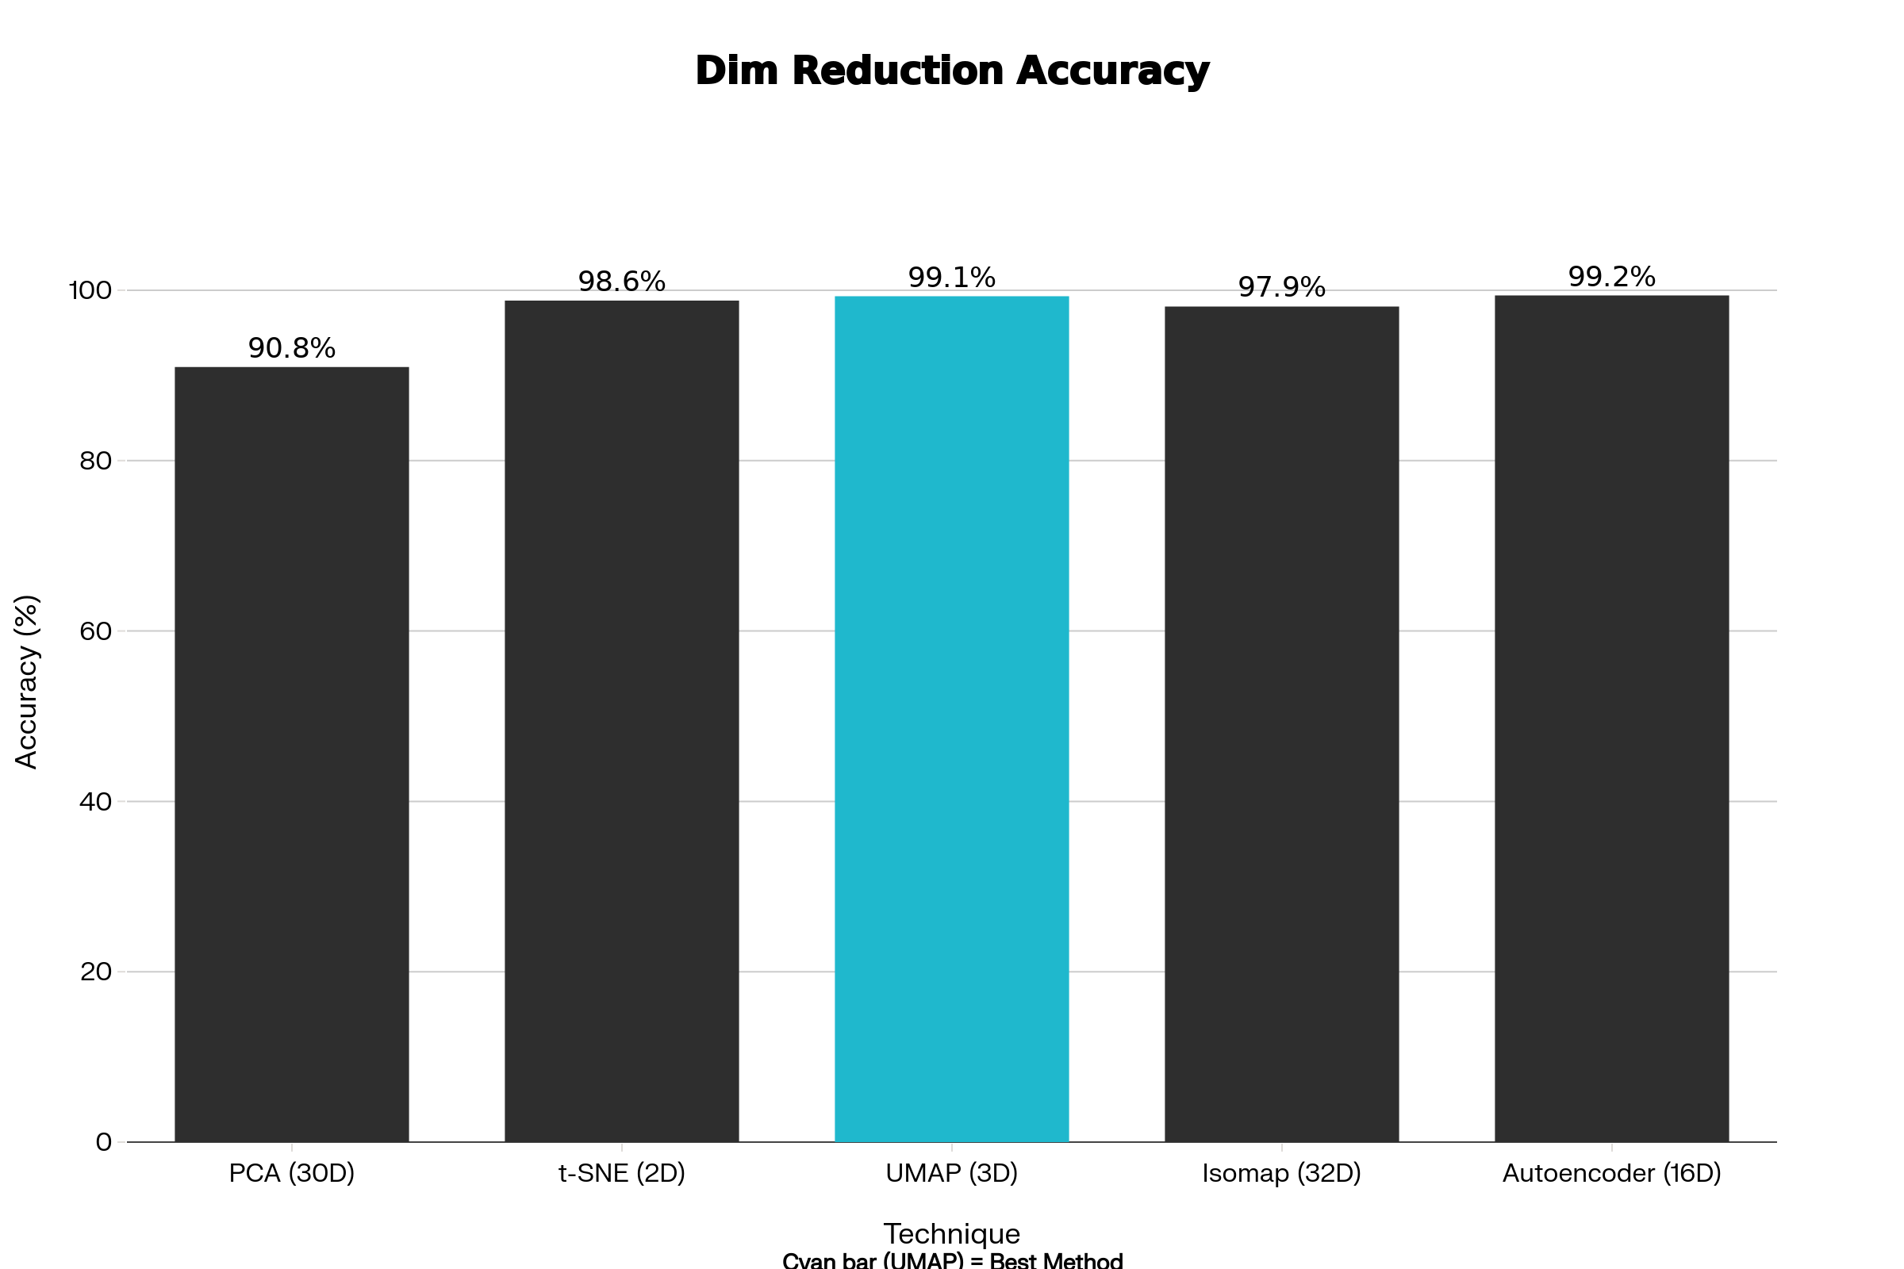
Dimension Reduction Methods: CIFAR-10

Slide 9
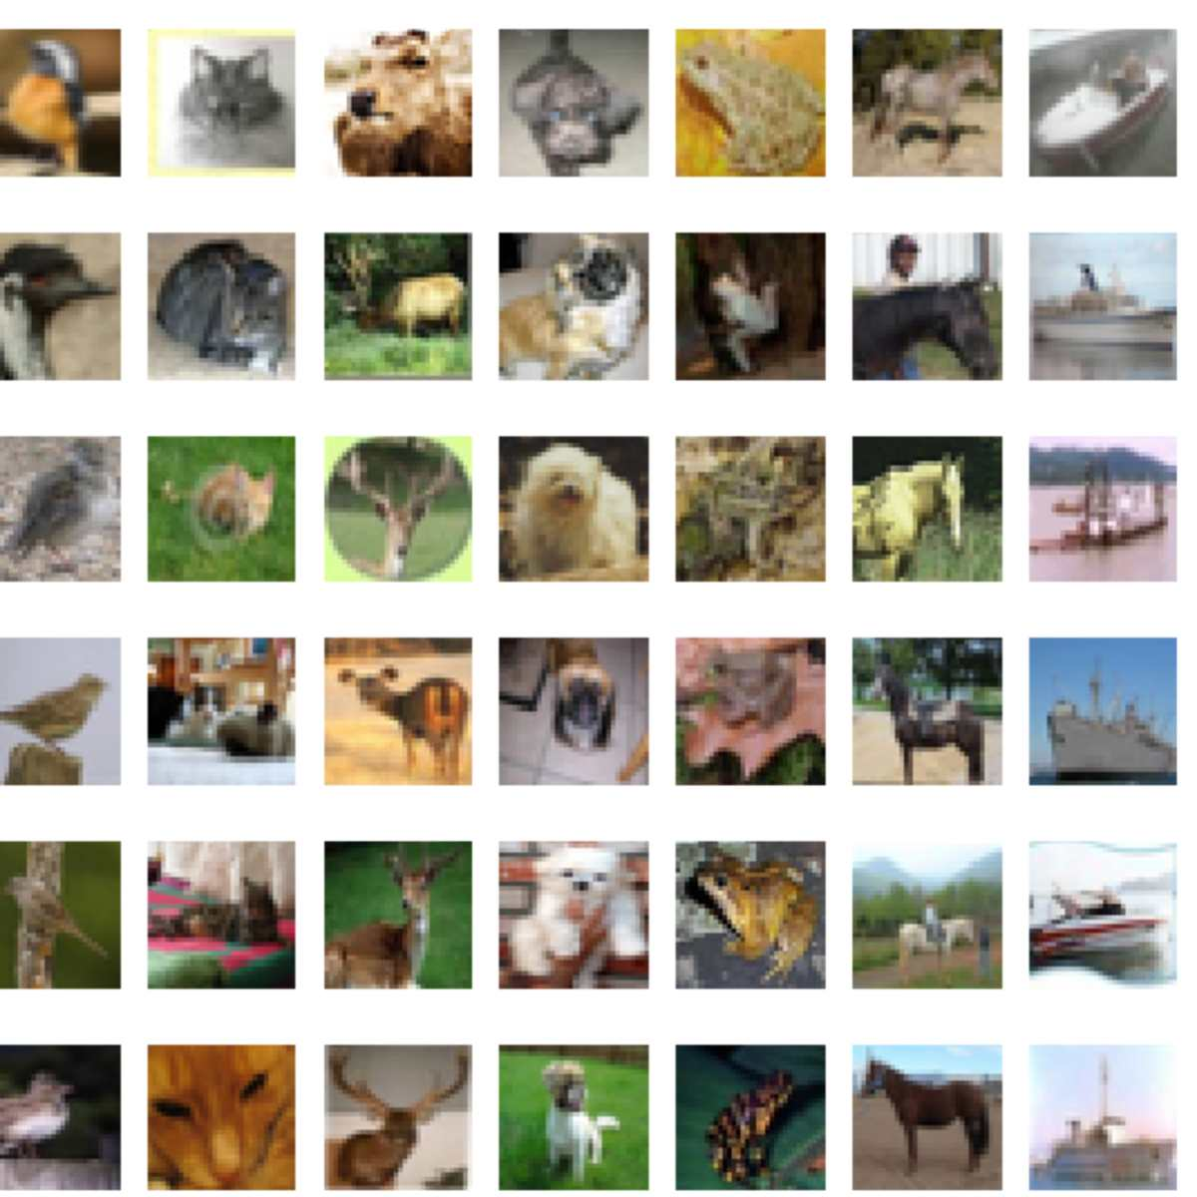
Benchmark Datasets
CIFAR-10, CIFAR-100, ImageNet-100, Tiny ImageNet

Slide 10
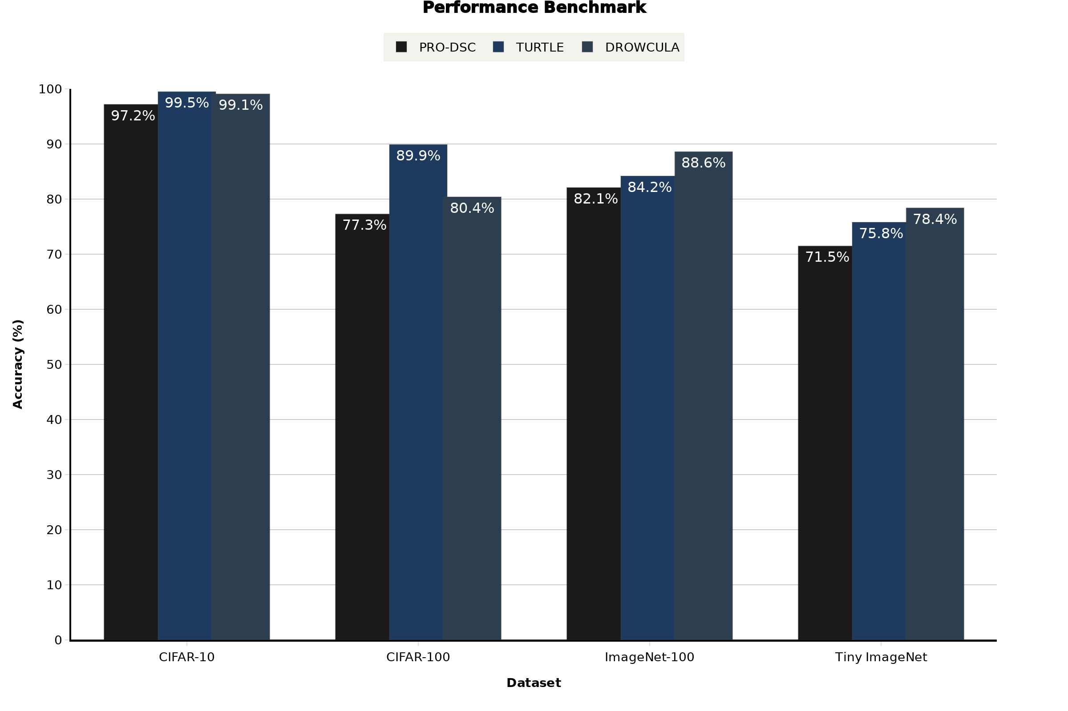
State-of-the-Art Results Across Datasets

Slide 11
Vision Transformer Architecture
Patch Embedding → Transformer Blocks → Feature Vector

Slide 12
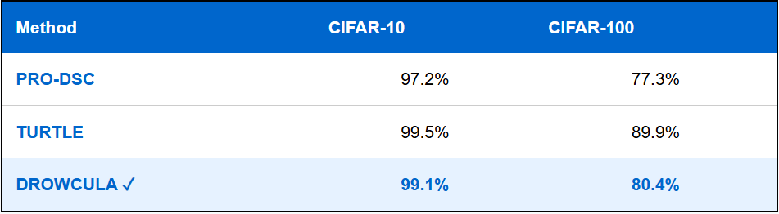
CIFAR Benchmark Results

Slide 13
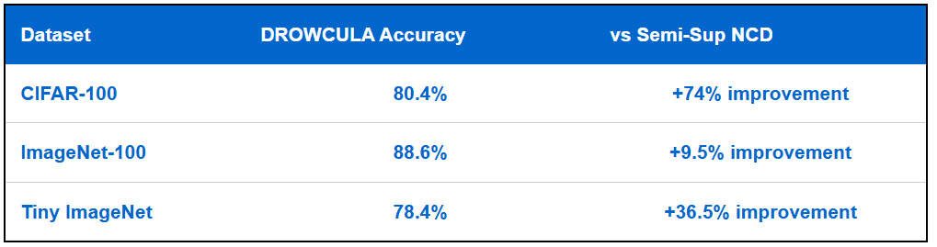
Novel Class Discovery: Fully Unsupervised!
DROWCULA beats all semi-supervised NCD methods:

Slide 14
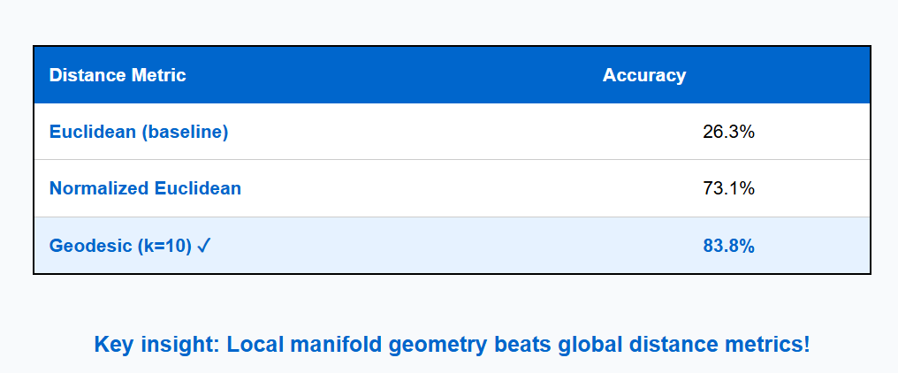
Ablation Study: Distance Metrics Matter
CIFAR-10 Results with FasterMSC Clustering:

Slide 15
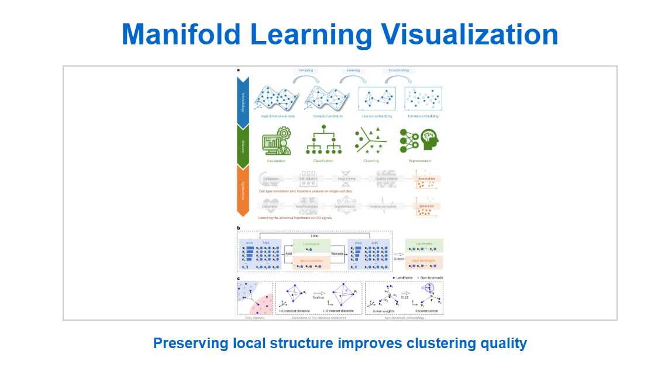

Slide 16
Ablation Study: ViT Feature Extractors
Key finding: Dimension reduction improves ALL feature extractors
Best performer: DINOv2-giant with 1536D → 3D reduction
Memory efficiency: 512× reduction in dimensionality!
Accuracy gains: Clustering improves despite dimension loss
Insight: Pretrained ViT + manifold learning = winning combination

Slide 17
Cluster Count Estimation: Bayesian Optimization
Challenge: Unknown number of clusters in open-world scenarios
Solution: Maximize Silhouette Score using Bayesian Optimization
Efficiency: Intelligent search avoids brute-force enumeration
Accuracy: Pseudo-labels exceed 99% on CIFAR-10
Practical: Works for datasets with varying cluster counts

Slide 18
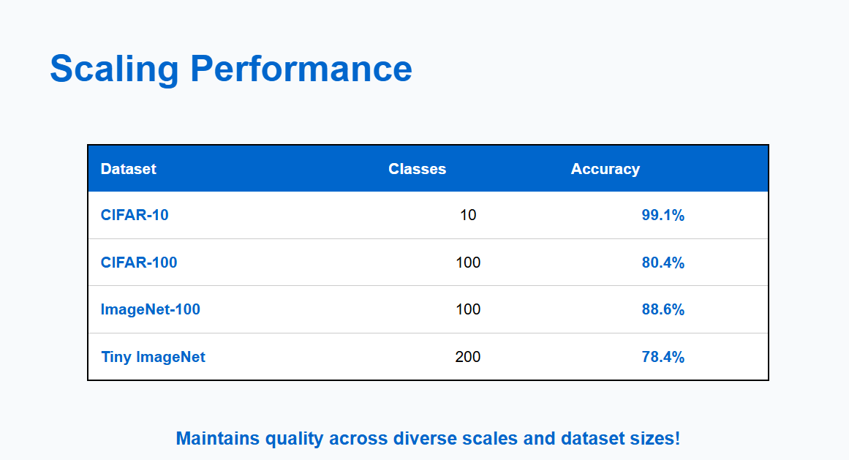

Slide 19
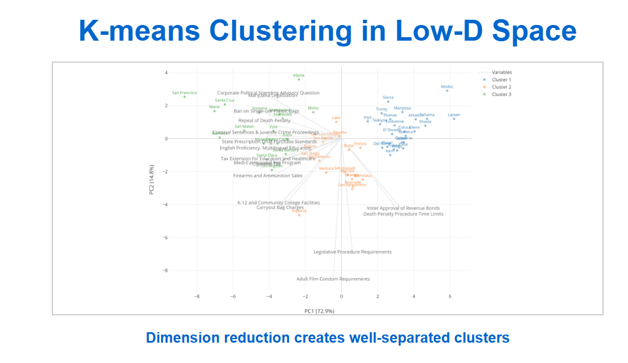

Slide 20
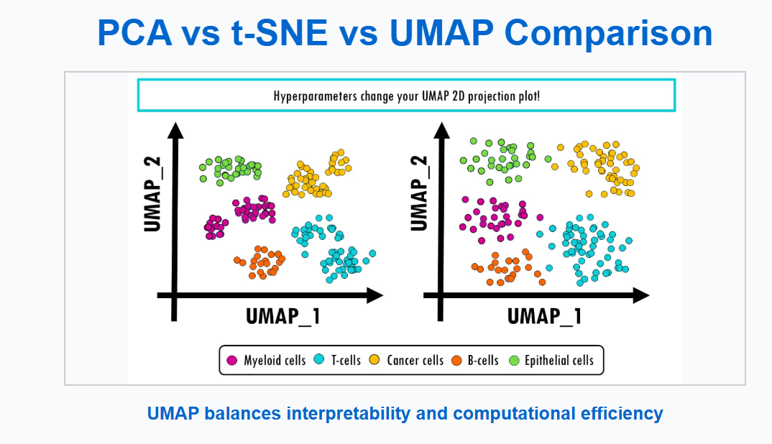

Slide 21
Implementation Details
Feature extractor: DINOv2-giant (1536 dimensions)
Normalization: L2 normalization ensures unit vectors
Dimension reduction: UMAP with 3 output dimensions
Clustering: K-means or FasterMSC on reduced space
Optimization: Bayesian optimization for automatic k selection

Slide 22
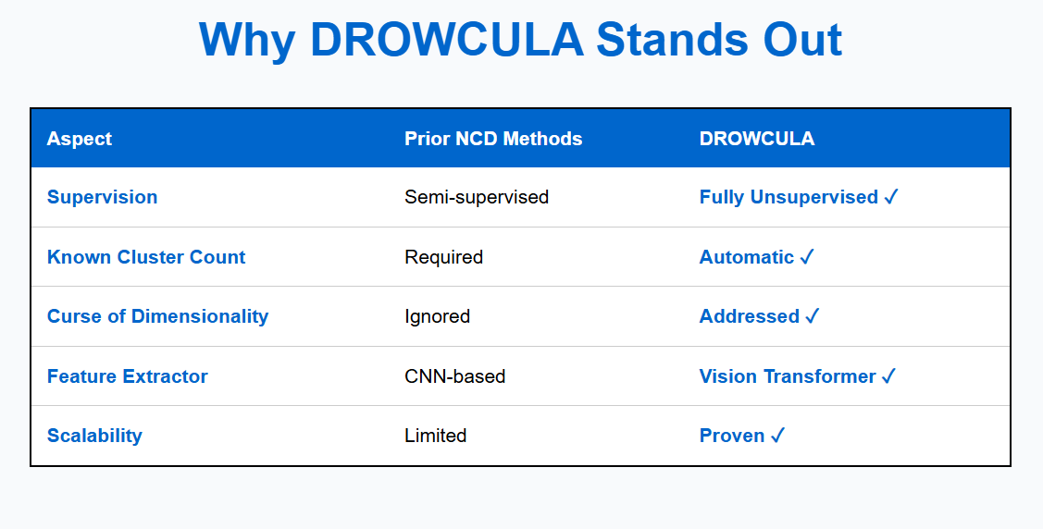

Slide 23
Key Contributions
Novel approach: First to combine ViT + manifold learning + clustering
Theoretical insight: Addressing curse of dimensionality improves clustering
Practical achievement: Beats semi-supervised methods using only unlabeled data
Scalable: Works on datasets from CIFAR-10 to Tiny ImageNet (200 classes)
Automatic: No need to specify cluster count beforehand

Slide 24
Real-World Impact & Applications
Medical imaging: Discover novel disease patterns without manual labeling
Foundation models: Unlock self-supervised learning on unlabeled datasets
Content discovery: Automatically categorize web images or documents
Anomaly detection: Identify rare or novel events in sensor data
Scientific discovery: Explore new phenomena in experimental data

Slide 25
Future Research Directions
Hierarchical clustering: Discover cluster hierarchies automatically
Multi-modal learning: Extend to text, audio, and video data
Continual learning: Handle streaming data with new clusters arriving over time
Interpretability: Understand what makes clusters distinct
Hardware efficiency: Deploy on edge devices and mobile platforms

Slide 26
Key Takeaways
✓ Fully unsupervised beats semi-supervised methods
✓ Vision Transformers + manifold learning = powerful formula
✓ Works at scale across diverse image datasets
✓ Automatically handles unknown cluster counts
✓ Opens new possibilities for foundation model research

